Slide 1
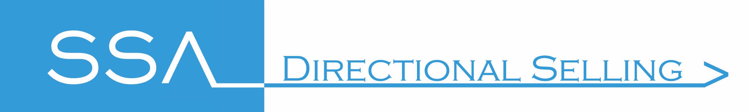
Cold calling
Copyright Sales Skills Audit Ltd, 2020
Notes:
This presentation looks at Cold Calling techniques

Slide 2

Cold calling - think of rocket fuel
When you are cold calling you need maximum technique and energy all wrapped up in your opening 10 seconds. Just like a rocket burning 99% of its fuel at the start of a journey.
You have less than 10 seconds to engage the prospect and start a new sales journey.
“Hi, how are you doing today?”
Bang! You’re out of fuel!
Notes:
﻿When you are cold calling you need maximum technique and energy all wrapped up in your opening 10 seconds. Think of a rocket heading up to space. 99% of all its fuel is exhausted in this first 0.00005% of the journey
The same should be reflected by you when cold calling. Basically, you will have 10 seconds, perhaps just 5, to prove to a new client that you are worth speaking with, so if you’ve just asked a meaningless question such has “Hi, how are you doing today?” your fuel is burnt!

Slide 3
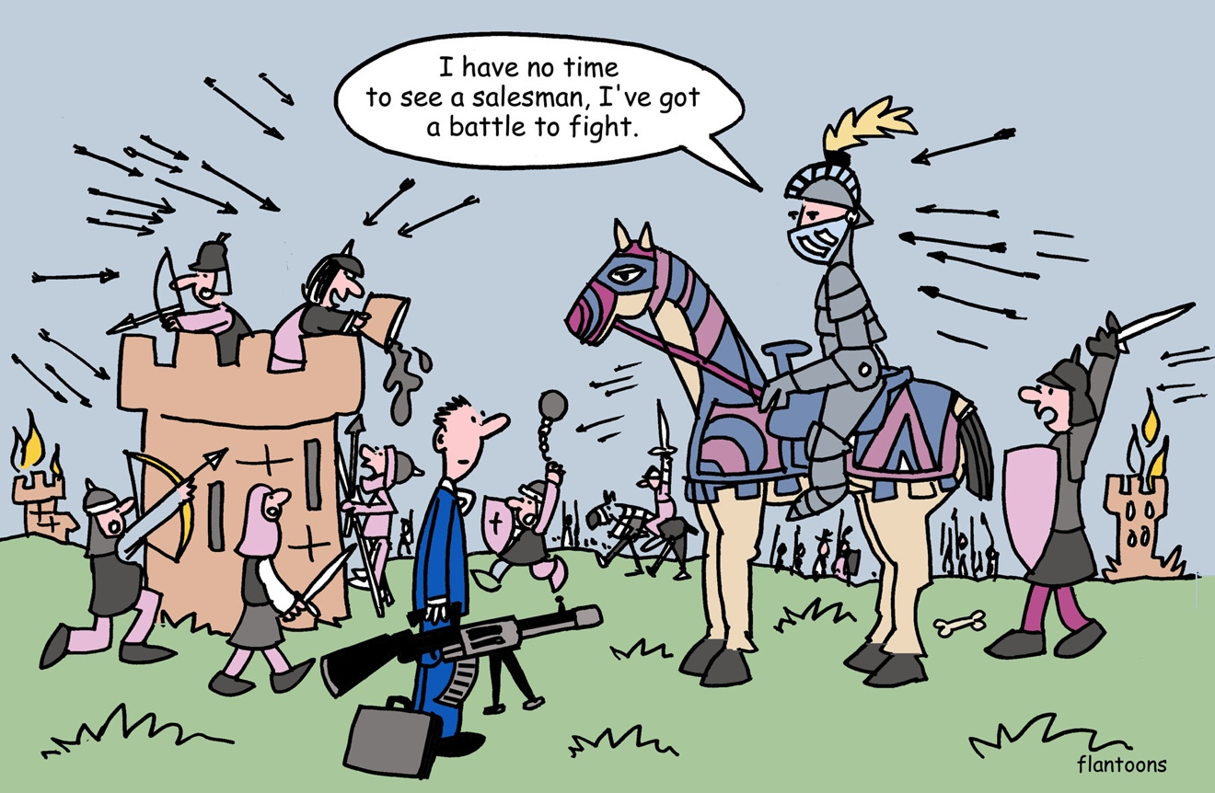
A great product won’t save you
It doesn’t matter how good – needed – or revolutionary your product is.
If you don’t get the client to engage in the first few seconds, you are done!
Notes:
﻿It doesn’t matter how good – needed – or revolutionary your product is. If you don’t get the client to engage in the first few seconds, you are done!

Slide 4
Make your 10 seconds count
In your first 10 seconds you must:
Control tonality: your voice must rise and command interest to draw your prospect in;
Use an introductory line that ends positively, upbeat and ‘logically a good idea to learn more’
Convey a first impression that oozes ‘interesting and intelligent’.
Notes:
In your first 10 seconds you must:
control tonality: your voice must rise and command interest to draw your prospect in;
use an introductory line that ends positively, upbeat and ‘logically a good idea to learn more’; and finally
convey a first impression that oozes ‘interesting and intelligent’.

Slide 5
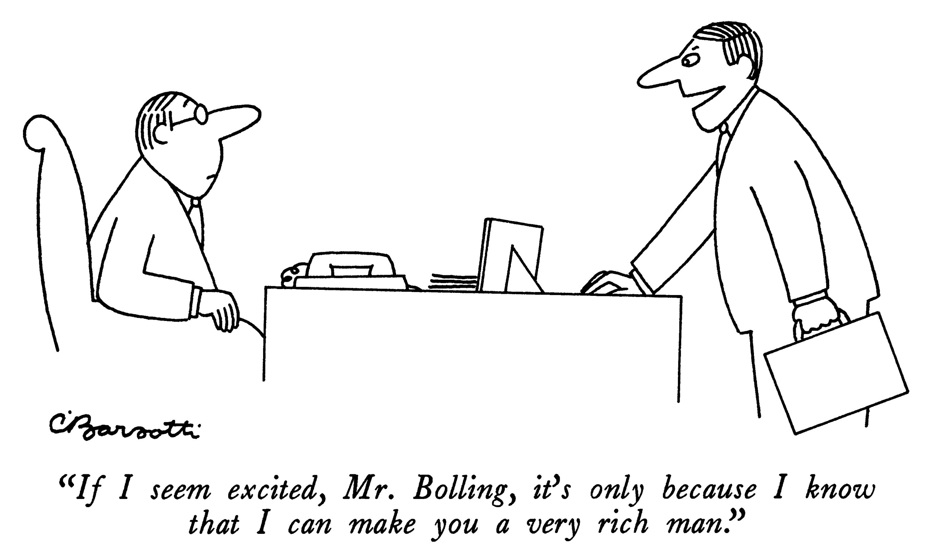
Grab attention
Perhaps not your style by way better than “How are you doing today?”
Notes:
Okay, this perhaps requires sharpening but I guarantee you that it will gain better traction than “How are you doing today?”
Take time to work out a ‘killer intro’ line that you feel comfortable with.

Slide 6
Plan your cold calling sessions
There is no denying that cold calling can be tough, so it is important to plan your sessions and break them up:
Exercise before a session, like an athlete – warm up physically.
Stand up. How many concerts have you attended where the lead singer sits?
Prepare. Plan in advance what you want, number of leads, appointments, pitches. What will ‘good’ look like and how will you know when you are done?
Notes:
There is no denying that cold calling can be tough, so it is important to plan your sessions and break them up:
Exercise before a session, like an athlete – warm up physically.
Stand up when making calls. How many concerts have you attended where the lead singer sits?
Prepare. Plan in advance what you want, number of leads, appointments, pitches. What will ‘good’ look like and how will you know when you are done?

Slide 7
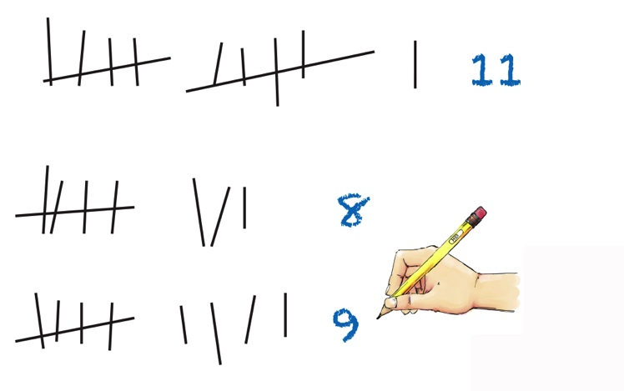
Learn your conversion rate
Track your sessions.
Perhaps it takes 5 dials to make a contact; 2 contacts to get an appointment? Great, 9 dials and the next call you will score a hit. Easy!
Notes:
﻿Track your sessions.
Everyone will have a conversion rate, perhaps 5 dials for a contact, 2 contacts for an appointment. Great, so if 10 number-dials means you get one, now you know the other 9 dials, with a couple of rejections, are simply steps towards your goal. Keep track of your conversion rate.

Slide 8
Practice your killer intro
Practise and record it.
Change and tweak your ‘killer intro’ as you go along.
Have a group session with colleagues and compare how they work.
Consider it as an alternative close: it is about when they speak with you, not if.
Use tonality to sound interesting and intelligent!
This is why we don’t do…
“Hello, I’m Steve from XYZ corp. How are you doing today?”
and do do…
“Hi, I’m Steve from XYZ corp., we’re the company that improve production flow in your sector, sometimes doubling it. You got a minute?”
Notes:
As for your intro pitch, write, practise and record it. Change and tweak your ‘killer intro’ as you go along. Monitor what works best and try to improve upon it. Have a group session with colleagues and compare how they work. Treat your intro pitch as an alternative close: it is about when they speak with you, not if. And your ‘tonality’ is going to urge them to take a little bit more of you on board now rather than later because you sound interesting and intelligent!
This is why we don’t do…
“Hello, I’m Steve from XYZ corp. How are you doing today?”
and do do…
“Hi, I’m Steve from XYZ corp., we’re the company that improve production flow in your sector, sometimes doubling it. You got a minute?”

Slide 9
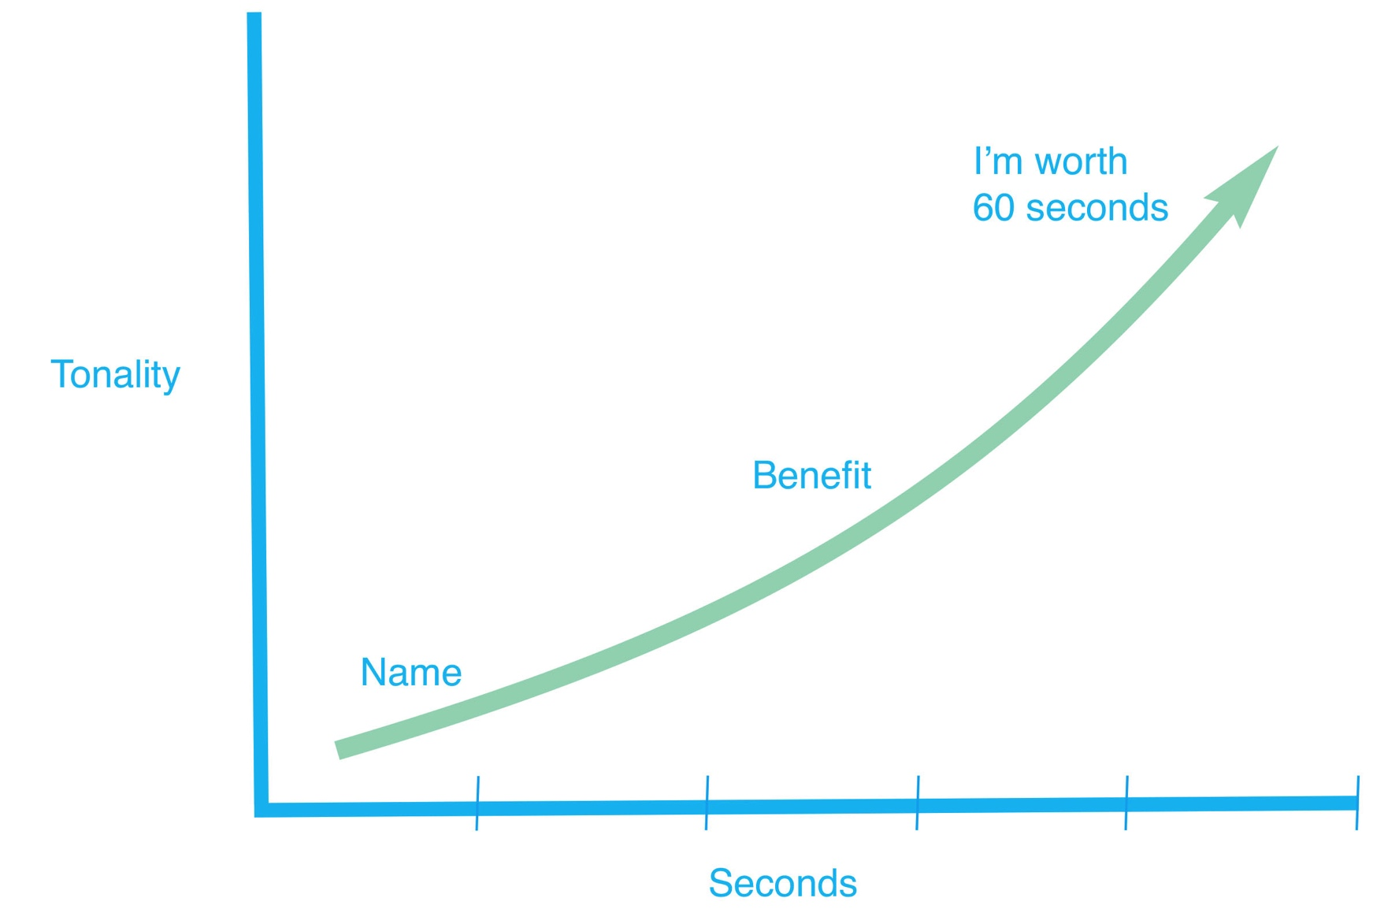
Use tonality to your advantage
Finish your opening pitch with upwards tonality. You raise your voice.
Notes:
Finish your opening pitch with upwards tonality. You raise your voice as you get to the end of your killer intro.
Sure, you want more than a minute but this is all about grabbing their attention with these three snippets of information: “I am – I can – in 60 seconds”.
Finally, make the calls! Sounds obvious but you would be surprised at how many sales executives avoid cold calling simply based upon a couple of past rejections they recall over the many wins. This is why it is so important to keep a record of your calls and know your conversion rate.

