Slide 1
Always face the close
Copyright Sales Skills Audit Ltd, 2020
Notes:
This presentation looks at the Directional Selling path and its journey towards the Close.

Slide 2
The directional selling path
The Directional Selling path is like a journey…
… if you are not heading in the right direction, towards Closing, you are lost.
Notes:
When you are travelling, you are heading towards your final destination. If not, you are lost! Directional Selling is no different. You should always be facing your destination – the close.
This is simply a matter of understanding the basics of the sales structure and knowing, at any given point, where you are in the sales pitch. No two meetings are ever the same, so you will need a combination of core selling skills and knowledge of the ‘Directional Selling map’ to keep you on course.

Slide 3
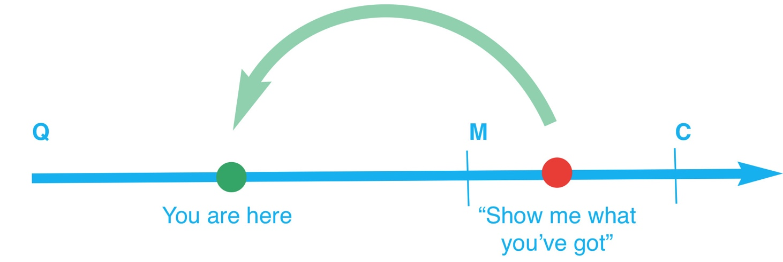
Imagine this….
You’re with a client and it seems to be going well. You are in the middle of qualifying…
BANG! “Show me what you’ve got and I’ll tell you if I’m interested.”
The client is forcing you down the selling path. You have to get them back to your position.
Notes:
So, let’s expand upon this in a sales scenario. Your direction is left to right and you are heading towards the close, simple. Your persistence won you an appointment with a key buyer and your dynamic personality is holding their attention. The buyer seems to like you and the meeting is of a relaxed nature. So, perhaps, you question the importance of the Directional Selling map…
BANG! The buyer chucks a grenade in and rocks your smooth pitch. “Show me what you’ve got and I’ll tell you if I’m interested.” Where did that come from? You’re only half way through asking questions! What should you do?
Take a look at where the client is forcing you: on to the next step. You’ve got to get them back in sync with your flow.

Slide 4
…and even worse…
You leave your position on the path and demonstrate a product.
BANG! “So how much is that?”
Now look what has happened, the client has fast-tracked you to Closing and is making a decision.
Notes:
This is when core selling skills are essential! Your dynamic personality will not rescue this back into a closable scenario because if you whip out a product now, the next question will almost certainly be: “So how much is that?”
Now look at the problem. Your client is making a decision and you have no ammunition (answers to your qualification questions) to work with! The journey back is even further.

Slide 5
Get them back on your step
This is why you must always know where you are on the Directional Selling path.
Identify where you are
Get the client back, “Sure, let me just ask a couple more questions and I’ll then know which product to show you first”
Or use an interim close so that the client agrees to return afterwards, “Okay, let me show you one product but then can we explore what your requirements actually are so that I don’t sell you the wrong one?”
Notes:
This is why it is essential to know where you are on the sales path and in which direction you are heading. A professionally trained sales executive will recognise this situation and use both personality and skill to steer the meeting back to their chosen point on the map.
When a client tries to fast track you down the path, you have what we call an ‘interim close’ situation. You must get the client to agree that if you deviate off the path, they will – in return – allow you to resume where you left off.
For example, if “Sure, let me just ask a couple more questions and I’ll then know which product to show you first” doesn’t work, your interim close might be: “Okay, let me show you one product but then can we explore what your requirements actually are so that I don’t sell you the wrong one?”

Slide 6
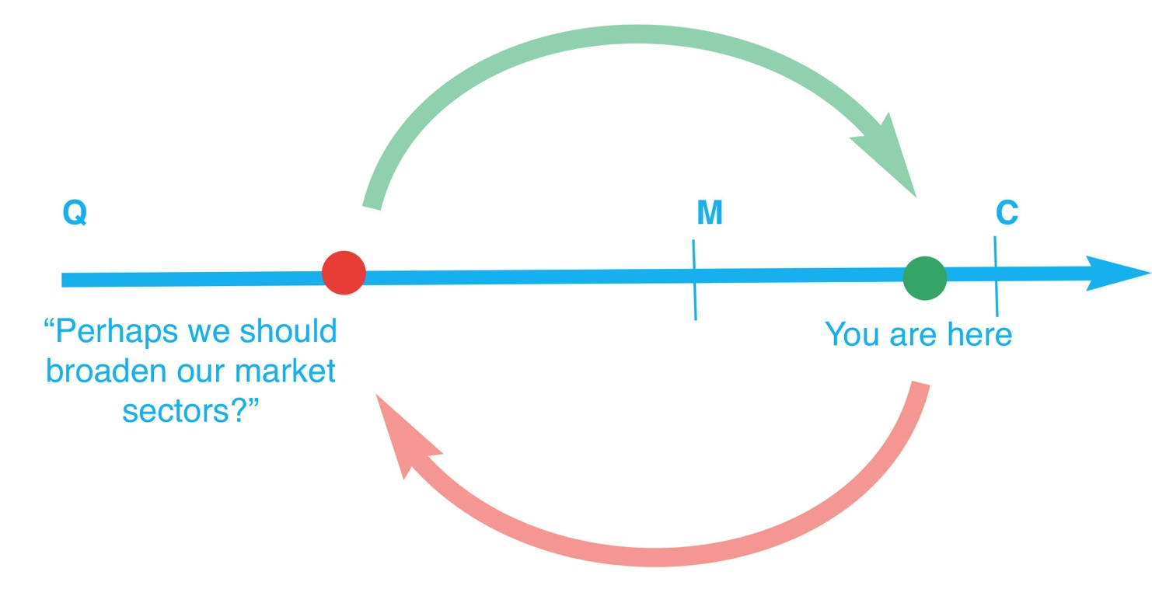
Don’t get in a spin…
Clients have many ‘grenades’ of different kinds. Distractions, taking a call, random thoughts…
BANG! “I wonder if we should broaden our market appeal, perhaps sell to the food industry too?”
Notes:
Clients have ‘grenades’ of all shapes and sizes. Common ones are distractions or incoming telephone calls. Use the Directional Selling map to pause the process and document where you are on the path. When you resume, use your notes to confirm with the client where you are and quickly recap the questions and needs/matches thus far before you continue.
Sometimes the client will spin you around and reverse the journey with random speculation such as “I wonder if we should broaden our market appeal, perhaps sell to the food industry too?”

Slide 7
Turn them back to the close…
Don’t panic and stick to your Directional Selling training to steer them back.
Address the question
Qualify their new needs
Add to your notes
Take them back to your step
Continue to the Close
Notes:
Now you have a change of direction and more qualifying questions to document around this possible opportunity, fine. But remember the selling path direction. Ask the questions, document the needs, get them back to the match and facing the close with the appropriate information.
So, in summary, no matter what clients chuck your way, do not lose sight of where you are and which direction you are facing on the Directional Selling path. And make sure the client joins you – not the other way round!
Copyright Sales Skills Audit

