Slide 1
3 Step Directional Selling
Copyright Sales Skills Audit Ltd, 2020
Notes:
Today we are going to cover the three steps of Directional Selling. The bedrock of a consultative sales process.

Slide 2
Three simple steps
These three, simple steps can be applied to all styles of selling, no matter what sector you are in:
Step 1 : Qualify
Questions. Questions and more questions. What does your client do? Make sure to ask questions that relate to your line of business and will help find a match.
Step 2 : Matching
Do any of these ‘needs’ match your product or service solution? Only now is the time to reveal and explain how they meet these ‘need’ requirements.
Step 3: Closing
With your ‘matches’ identified, the close should be auto-intuitive. Asking for the business should make sense to both parties.
Notes:
These three, simple steps can be applied to all styles of selling, no matter what sector you are in:
Step 1 : Qualify Questions, questions and more questions. What does your prospect do and what would make that process better? You are prospecting for ‘needs’ but remember to cover the ground of where your solution (your product) lies (questions that will help match your service as the solution later on).
Step 2 : Matching Do any of these ‘needs’ match your product or service solution? Only now is the time to reveal and explain how they meet these ‘need’ requirements.
Step 3: Closing With your ‘matches’ identified, the close should be auto-intuitive. Asking for the business should make sense to both parties.

Slide 3
The Directional Selling path
During the career of a sales professional, we pick up little suitcases of information and experiential memories, both techniques and previous meetings.
Your style may change over the years but always stick to the fundamentals, the Directional Selling 3 steps
Note the importance of Qualifying, 70%. Get this right and matching will be easy and closing with fewer or no objections. Always keep track of where you are on this path during the sale to avoid derailment by distractions.
Notes:
During the career of a sales professional, we pick up little suitcases of information and experiential memories, such as closing techniques from a seminar, cold-calling skills from a book, or perhaps memories of winning a big order and what seemed to work with that particular close. Then, of course, the fear of the rabid dog who was simply having a bad day yet successfully planted the seed of doubt that occasionally awakes within you.
Whilst all this is perfectly natural, top performing sales executives never lose sight of the fundamentals – the bedrock three steps of the Directional Selling path. Note the importance that is placed in the time spent qualifying. Do this right and Matching will be easy and Closing almost automatic.
Every meeting or call will differ. In some cases, it will be easy to stick to your Directional Path. On other occasions, the client will cause you to jump around a bit. When this happens, maintain a level head and keep track of where you are on the three-step path, irrespective of random questions that a buyer may chuck your way. See our Direction Selling course “Always face the close” for more details on this.

Slide 4
Qualifying – 70%
Qualifying is the most important of the three steps. It will allow you to:
Identify opportunities
Document matches of client needs with your product or service
Ensure you do not mis-sell
Make the whole process enjoyable
Whilst qualifying:
Share the notes with the client and underline points of importance
Use them to sum up and concur nothing has been missed
Notes:
Qualifying is by far the most important of the three steps, which is why we’ve weighted it with approximately 70% of the selling path.
Correct qualifying questions will:
identify opportunities;
document direct matches of ‘needs’ with your product or service;
ensure that you do not mis-sell and
take the pressure out of selling and making the whole process more natural.
Whilst asking qualifying questions, take notes. Show the prospect that you are writing their answers down and therefore taking them seriously. Furthermore, use these notes to sum up what the prospect has told you, making sure they concur and that nothing has been missed.
Key skills here are Asking Probing Questions and Listening.

Slide 5
Matching – 20%
Now it is your turn to do the speaking, show them what you have got:
Use your notes throughout this step
Further underline/highlight strong matches
Involve the client with your thinking and logic
Test close with language such as “do you see” and “do you agree”
Number match priorities for more complex sales
Whist matching use these test close questions to ensure the client is moving along the Directional Selling path with you.
Notes:
Now you can talk about what you do and how your company can meet their requirements. Use your notes throughout this process and underline the most striking matches with the requirements as you go. Let the prospect understand the logic in what you are starting to propose. Involve them in the match-making process by using language such as “you said that you were looking for something to solve this problem” and “do you agree that this product looks suitable for that?”
This language will help you test-close, and using your notes to reinforce this (underlining items) will further move the two of you towards the close. With a more complex offering, it might be useful to number or prioritise matches.

Slide 6
Closing – 10%
With the first two steps completed correctly, this should be straightforward:
So, based on what we’ve just discussed, do you agree that this is the right product for you?
So, now that we know which machine will do the job, we just need to decide on which model you prefer. Do you want the single or twin port? [the alternative close]
“Great, I’ll raise an order and get you locked in.” [the assumptive close]
If you’ve followed the Directional Selling path, closing should flow naturally:
Once the client has chosen lock them in
Stop selling and raise the order
Don’t over-sell
Notes:
With the first two steps completed correctly, this step should be the quickest and easiest part of the process. The conclusion should be intuitive, logical and pleasurable for both parties.
You should now know which product is right for the client and, hopefully, they will have already agreed during your test-close questions. This being the case, you can roll this summary into a simple “So, based on what we’ve just discussed, do you agree that this is the right product for you?”
Another great close is the ‘alternative close’ which can be deployed after successful matching: “So, now that we know which machine will do the job, we just need to decide on which model you prefer. Do you want the single or twin port?”
And, of course, we have the ‘assumptive close’: “Great, I’ll raise an order and get you locked in.”
All of these closing skills should flow naturally and without pain if you’ve followed the three steps of Directional Selling. And once the client has chosen, lock them in as agreed. Stop selling and raise the order. Don’t ‘over-sell.’

Slide 7
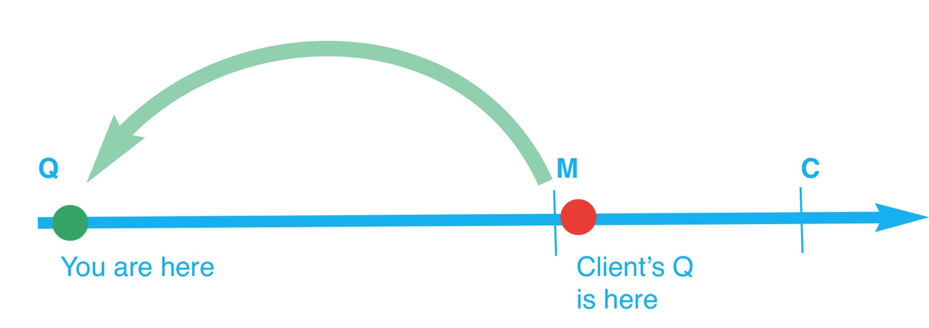
Stick to the directional selling path
Every meeting is different, you will have to stay sharp to keep on the path.
When a client greets you with “Okay, 10 minutes, what you got?” you need to get them back on the path with you… “Sure, but let me just ask a few questions first so that I show you the right ones.”
Notes:
Remember, no matter how chaotic the sales environment is, stick to the path. Perhaps you’ve just cold-called in a busy shop and managed to grab the owner for a minute. The reply comes: “Okay, 10 minutes, what you got? You must remember where you are and where you are heading on the Directional Selling path.
By understanding the three-step Directional Selling path, you will recognise where the client’s question is and the danger of simply doing as they request. Your job is to take them back to your point on the path. Perhaps a simple, “Sure, but let me just ask a few questions first so that I show you the right ones” will suffice.
Copyright 2020 Sales Skills Audit Ltd

