Slide 1
Objection handling
Copyright Sales Skills Audit Ltd, 2020
Notes:
This presentation deals with sales objections and considering where they lie on the Directional Selling path.

Slide 2
Objections in sales is natural
Objections can be a sign that the client is still engaged and is considering your offer
Firstly, decide if the objection is a realistic question or a red herring? Secondly, identify your position on the sales path.
In this example we think it is a red herring or ‘left field’ because the client can’t possibly know if this is the right product this early in the meeting (during Qualifying)
Notes:
Objections are a natural occurrence in the course of a sales journey, so expect for them to pop up from time to time. In actual fact, they are often a sign that your prospect is still engaged and considering your offering.
When an objection pops up, as always with Directional Selling, identify your position in the sales process and where the objection lies. Also, decide whether it is a realistic question on the selling path or a ‘red herring.’
In this example, we’ve charted the objection off the Directional Selling path because it is somewhat ‘left field.’ It is unlikely the prospect knows the answer to their question as it is too soon to be deciding upon the quality of a Match between their needs and your solution. For this reason, you should avoid the ‘right/wrong’ debate and return to asking more probing questions.

Slide 3
Getting the client back to your path
This objection is not realistic so we’ve plotted it off the Directional Selling path, so:
Avoid entering the ‘right/wrong’ debate
Try a simple correction line, “Let’s see. I have a couple more questions and then we can cut to the options. Is that okay?”
Have you simply lost their attention? Use a ‘benefit hook’ to regain focus and return to the selling path
Notes:
In this example, we’ve charted the objection off the Directional Selling path because it is somewhat ‘left field.’ It is unlikely the prospect knows the answer to their question as it is too soon to be deciding upon the quality of a Match between their needs and your solution. For this reason, you should avoid the ‘right/wrong’ debate and return to asking more probing questions.
However, it is possible that their attention is wandering so try and address this too. “Let’s see. I have a couple more questions and then we can cut to the options. Is that okay?”
Most ‘left field’ objections are red herrings. The client simply hasn’t bought into the purpose – the benefit – of your meeting. So, it is imperative that you don’t tackle the objection head on and return to Qualifying in order to identify a ‘benefit hook.’ This is an attention grabber from which you can regain control of the meeting.

Slide 4
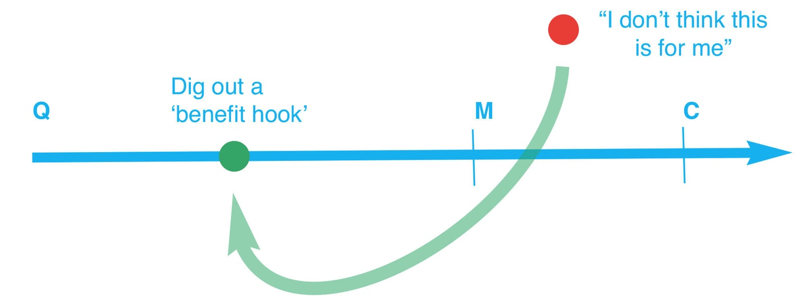
Sometimes it pays to agree…
You may be able to get them back on the path by agreeing and using a ‘benefit hook’
“You know what, you might be right but I’m just looking at my notes so far and I’m curious about what you said regarding the cost of a production line failure. I might have a solution here [benefit hook] but need to know a little more. You got a minute to expand on this?”
Always check what type of objection you are dealing with before you tackle it.
Notes:
Your job is to get them back on the Directional Selling path, focused. “You know what, you might be right but I’m just looking at my notes so far and I’m curious about what you said regarding the cost of a production line failure. I might have a solution here but need to know a little more. You got a minute to expand on this?”
Sometimes a prospect will use an ‘objection’ as a barrier to entry. It may be their way of saying ‘I’m not engaging with you because I don’t think you have anything of interest.’ Again, you must consider what is being said, and why, before you tackle it.

Slide 5
A sales scenario – advertising sales
Imagine a sales executive selling advertising to a local restaurant. They’ve just sat down with the owner when…
BANG: “ I’m sorry but I don’t want to waste your time. I just know advertising doesn’t work for my restaurant so I won’t be buying.”
Here’s what to do:
Check where you are on the selling path and where they need to return to
Identify the type of objection (realistic, loss of attention, a red herring?)
Consider the use of a ‘benefit hook’
Notes:
Imagine a sales executive selling advertising to a local restaurant. They’ve just sat down with the owner when… BANG! “ I’m sorry but I don’t want to waste your time. I just know advertising doesn’t work for my restaurant so I won’t be buying.”
I think we’ve all had such an experience, yes? So here’s how we deal with it.
Firstly, refresh your memory as to where you are on the Directional Selling path. This is always the first step so that you are clear where to pick up from once this matter is resolved. Secondly, identify what type of objection you are dealing with and what you want the outcome to be. In this case, it seems to be a lack of interest/benefit [benefit hook] and you want them back at the beginning of the selling path with you – engaged!

Slide 6
A sales scenario – advertising sales …cont
BANG: “ I’m sorry but I don’t want to waste your time. I just know advertising doesn’t work for my restaurant so I won’t be buying.”
Sometimes agreeing with a client works well. Here’s our suggested response in this situation:
Do you know, you might be right. There are some businesses for which we are not the right solution and others where we’ve successfully delivered a large volume of new clients. I certainly do not want to waste your time so can I ask you a couple of questions in order to find out which one you are likely to be?
Note that we have also used a ‘benefit hook’ – ‘delivered a large volume of new clients’ - to re-engage the client and avoided tackling the objection head on by partially agreeing with the client.
Notes:
A great diffuser is to first agree with a client, but be sure you know where you are going with the second part! “Do you know, you might be right. There are some businesses for which we are not the right solution and others where we’ve successfully delivered a large volume of new clients. I certainly do not want to waste your time so can I ask you a couple of questions in order to find out which one you are likely to be?”
Note how we’ve referenced ‘delivered a large volume of new clients’ – this was the ‘benefit hook’ used to re-engage the client’s attention.
Always try and avoid tackling an objection head on. The further you travel into proving an objection to be just baloney, the further you distance yourself from the client. This is especially true when the objection was a ‘red herring’ and they simply didn’t see the benefit of the meeting. Shoot them down at this point for being right and you’ll be shooting out the door!

Slide 7
Getting the client back to your path
Sometimes an objection is a valid concern and needs to be dealt with but always get the client to agree to returning to the sale process once addressed
You might be right, it doesn’t work for everyone, but if I can show you a few comments from other equally renowned restaurateurs who felt the same but are now my best customers, can we explore which category you fall into afterwards?
Testimonials are excellent diffusers for objections, especially when competitors are used!
Notes:
If you deem the objection to be a true concern that is going to distract throughout the meeting, fine, put it to bed.
But only do so after getting the client to agree how you will both proceed (on the selling path) if you can address this issue.
For example, “You might be right, it doesn’t work for everyone, but if I can show you a few comments from other equally renowned restaurateurs who felt the same but are now my best customers, can we explore which category you fall into afterwards?”
Testimonials are excellent diffusers for objections, especially when they reference a client’s competitors!

Slide 8
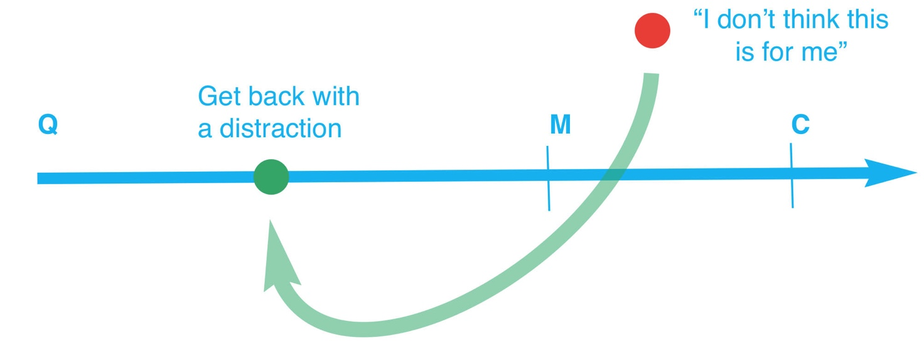
The ‘objection bat’
Some objections simply need ‘whacking over the hill’ and can be avoided by distraction
“ The picture of that famous actress on your wall…does she eat here?”
Clients love to talk about their business – and now you are back on the selling path!
Notes:
The ‘objection bat’. Always have a large bat to hand for whacking really silly objections over the hill.
The best ‘swing’ is always asking a random question about the client’s business such as, in our scenario, “ The picture of that famous actress on your wall…does she eat here?”
Clients love to talk about their business, which they are naturally really proud of, and guess what? You – and your client – are now back on the Directional Selling path!

Slide 9
The price objection
Some objections will require you to backtrack on the selling path.
A classic such objection is price. “It’s just too expensive.”
Other objections can arise if you’ve missed matching a feature/benefit with a need.
Notes:
Some objections will require you to backtrack on the selling path, perhaps because an element has been missed or a feature/benefit needs reinforcing.
A classic such objection is price. “It’s just too expensive.”

Slide 10
‘it’s too expensive’
A great response in this instance is:
“Is it because you think our machine is not value for money or would you struggle with the full cost right now?”
And the client replies, “It’s not the money, I just think I can buy similar for less.”
“Okay. If I can demonstrate to you that our model is better value for money against similar models on the market, would we have a deal?”
We are now closing the deal based upon an agreed journey back on the selling path.
Notes:
A great response in this instance is:
“Is it because you think our machine is not value for money or would you struggle with the full cost right now?”
And the client replies, “It’s not the money, I just think I can buy similar for less.”
“Okay. If I can demonstrate to you that our model is better value for money against similar models on the market, would we have a deal?”
We are now closing the deal based upon an agreed journey back on the selling path.

Slide 11
Backtracking to deal with an objection
Take the client back to ‘features and benefits in Matching
Use the objection to close the deal, “If I can address this, do we have a deal?”
Identify the appropriate ‘value for money’, perhaps your machine is quicker and therefore more productive than a cheaper rival machine?
Remember, this is why it is so important to Qualify properly and therefore have these notes to fall back on when dealing with an objection.
Notes:
This is where thorough Qualifying really pays dividends. In this scenario, the sales executive should have documented needs, wants and ‘pain points’ (situations that really concern the client and relate to possible solutions the sales executive can offer).
For example, in this case the salesperson should be matching machine reliability with the need to avoid production downtime or machine accuracy versus product recall.
Both represent real value for money when purchasing capital equipment. Perhaps the machine is quicker than a cheaper rival model, in which case more parts per minute equals better value for money.
Note that in this scenario the salesperson closed the deal because of this objection through clearly stating, “If I can address this, do we have a deal?” So, look at objections as closing opportunities.
They might clinch the deal but, if not, always use them to move further down the Directional Selling path.
Copyright Sales Skills Audit

